Slide 1
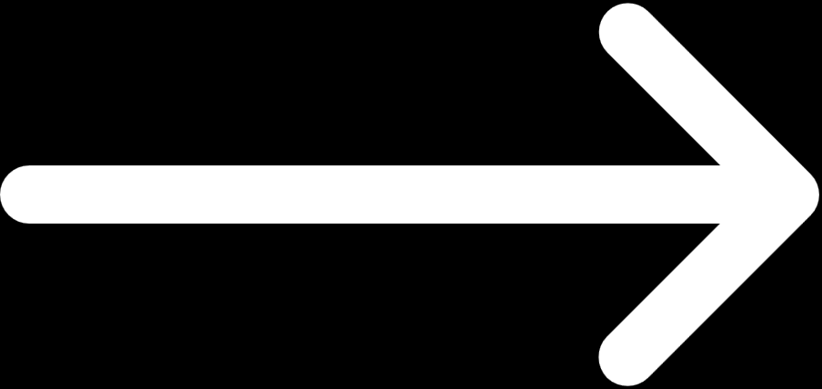
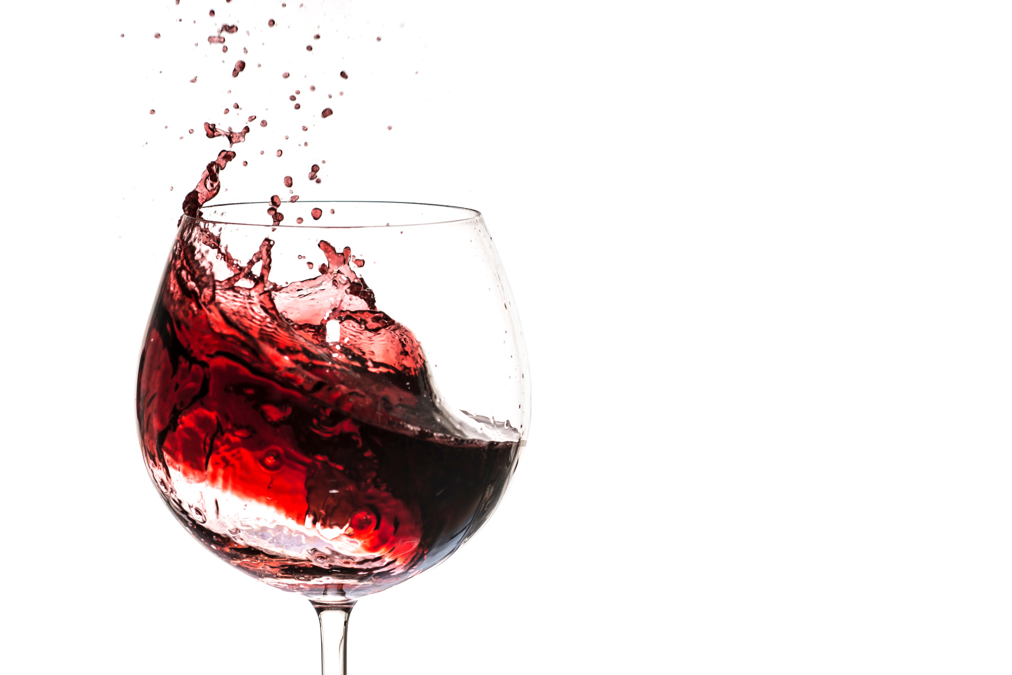
WINE QUALITY PREDICTION SYSTEM USING MACHINE LEARNING
GROUP MEMBERS
LAKSHYA DOGRA ( RA2211026030023 )
PRAKHAR AGARWAL ( RA2211026030014)
PARTH SINGH ( RA2211026030016 )
NAVNEET KUMAR ( RA2211026030013 )

Slide 2
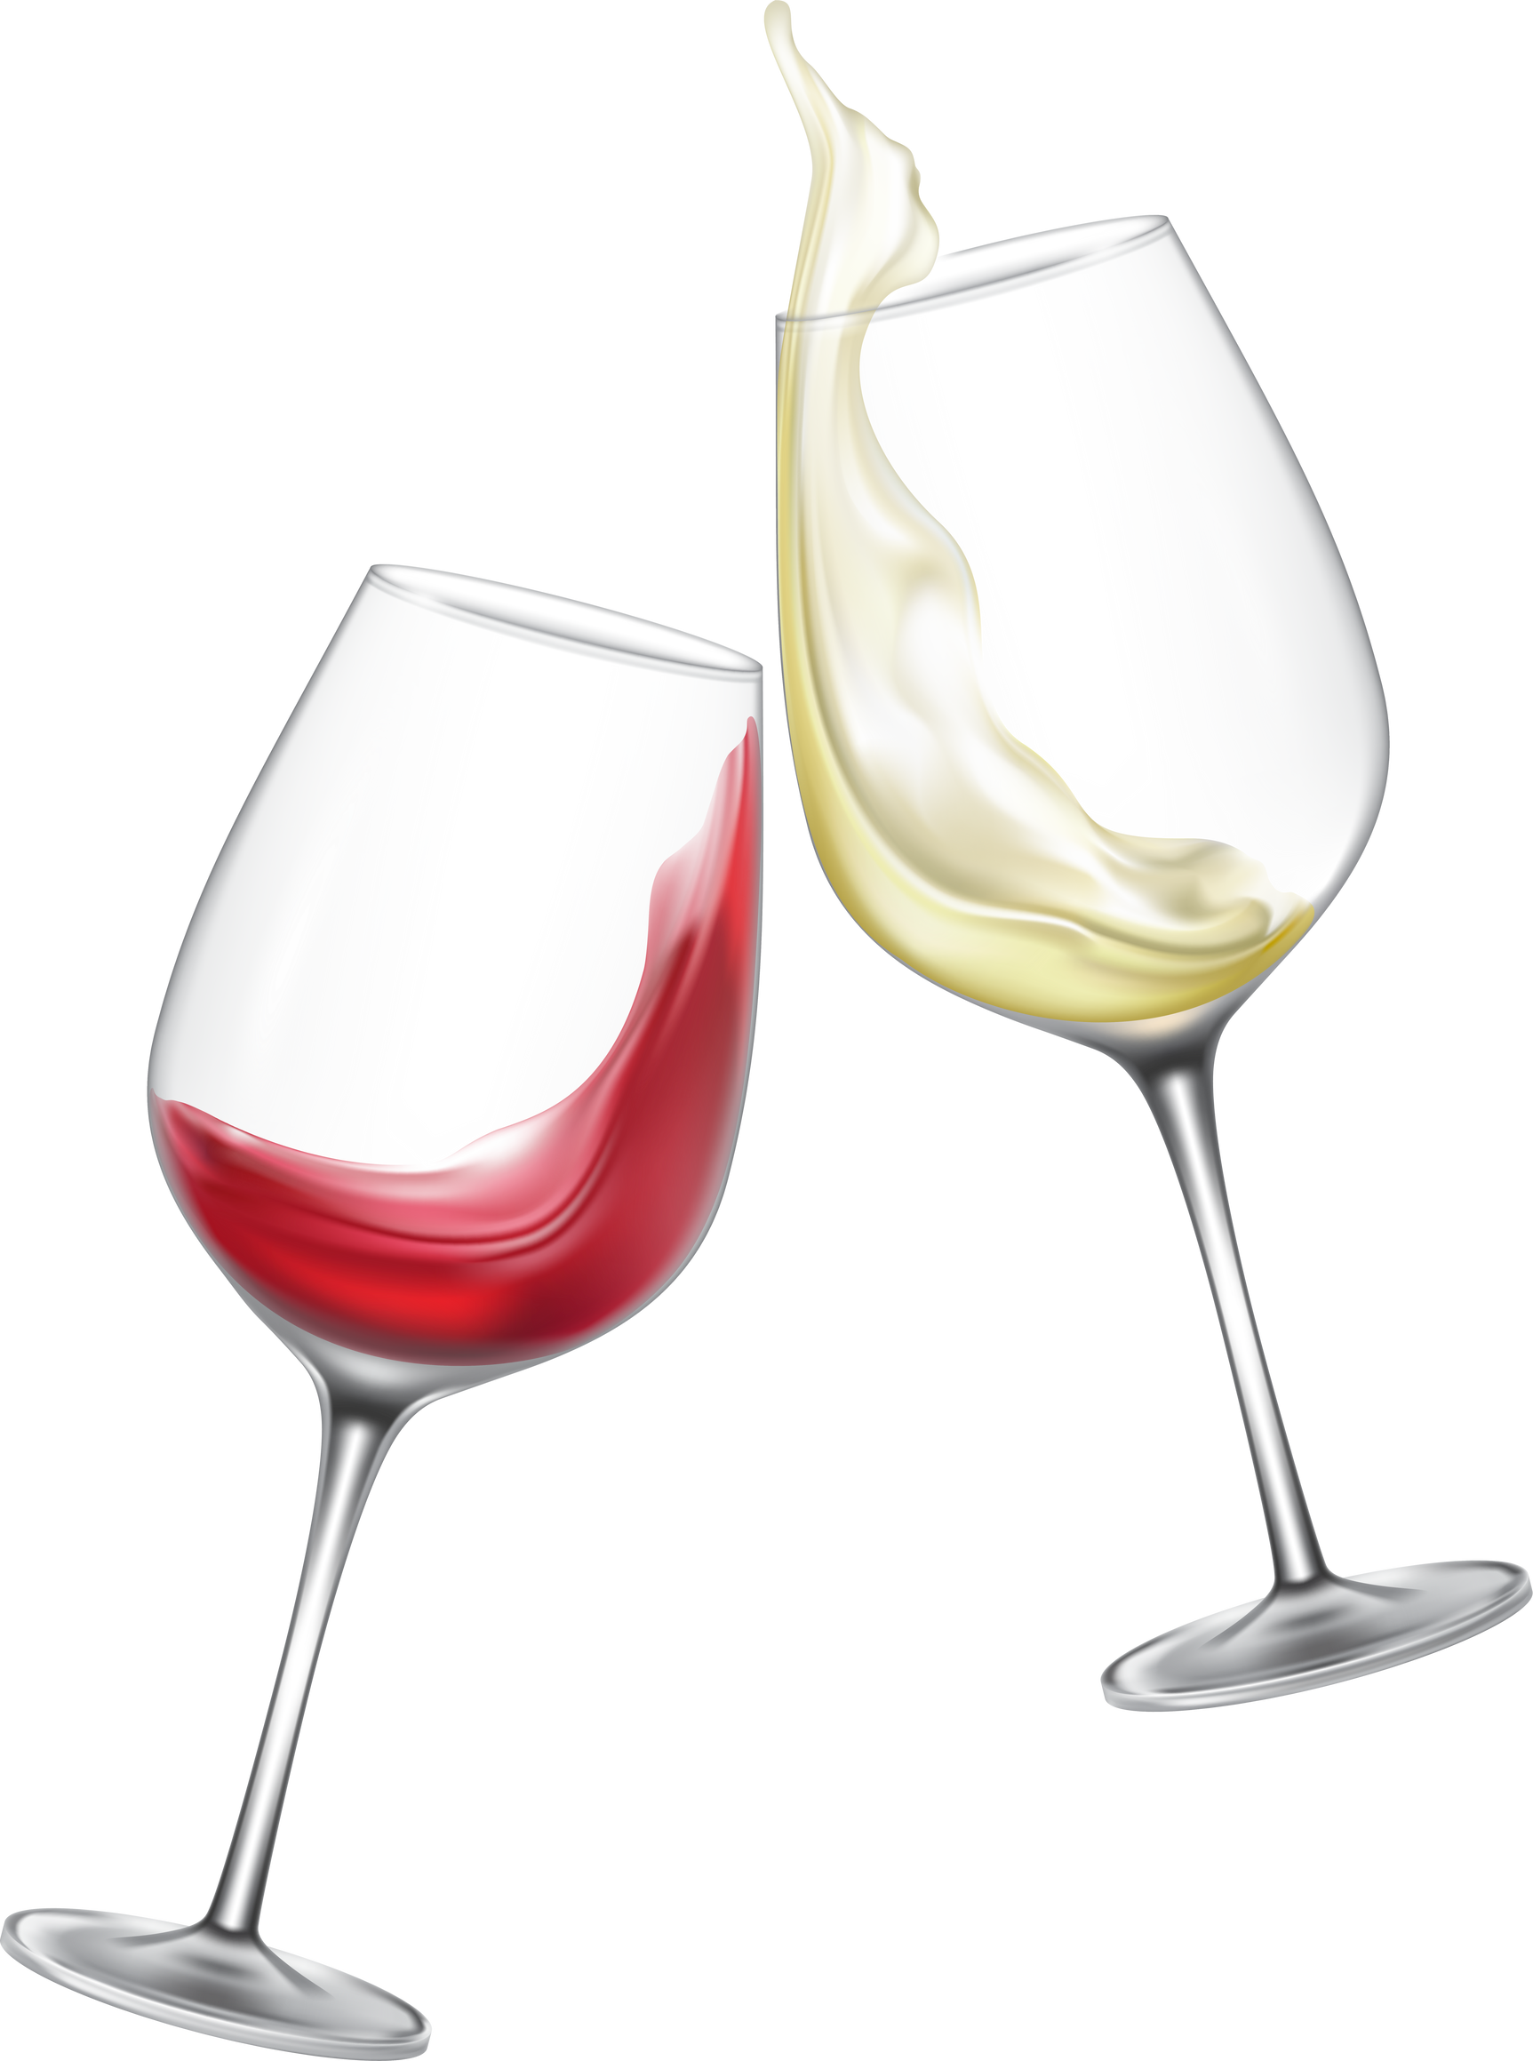

ABSTRACT
Objective: Develop a machine learning model to predict wine quality based on chemical parameters.
Method: Utilize the Random Forest algorithm trained on the Wine Quality Dataset from Kaggle.
Outcome: Achieve a model accuracy of 93%, facilitating efficient quality assessment for wine manufacturers.

Slide 3

INTRODUCTION
•Machine learning applications in the food and beverage industry.
•Use of chemical parameters to determine wine quality
•Role of machine learning in predicting wine quality
Problem Statement
•A wine company wants to create a new wine brand
•The goal is to predict wine quality using several chemical parameters
•Need for an automated system to classify wine quality

Slide 4
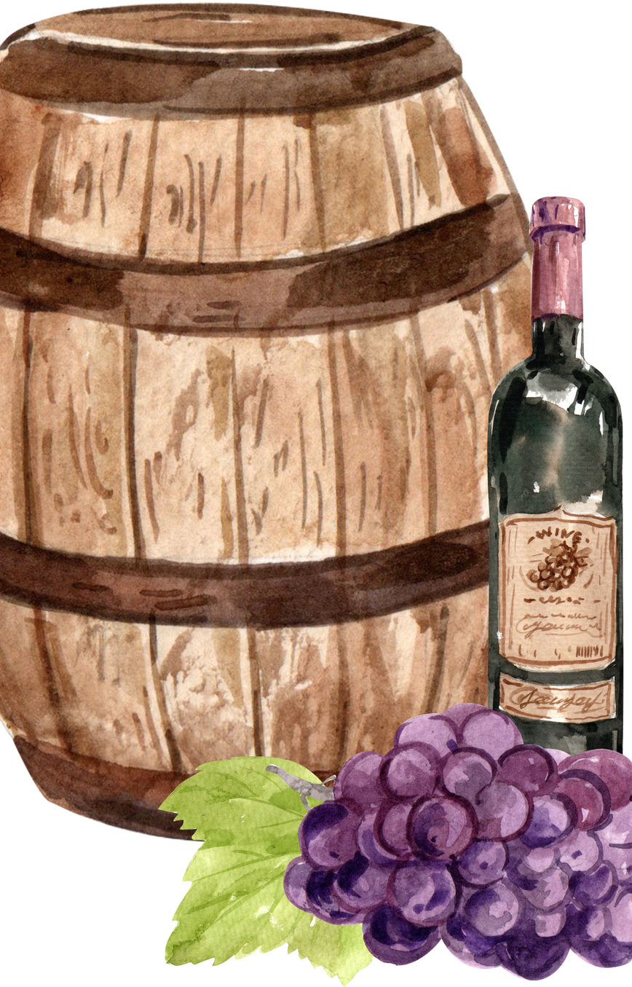
INTRODUCTION
SUPERVISED LEARNING
•For predicting wine quality, a labeled dataset contains chemical parameters (features) and their corresponding quality scores (labels).
•The model learns the relationship between these features and labels, allowing it to classify new wine samples based on their chemical composition.
MISSION
•Unsupervised Learning and Reinforcement Learning will be used in future models for analysis and data prediction.

Slide 5
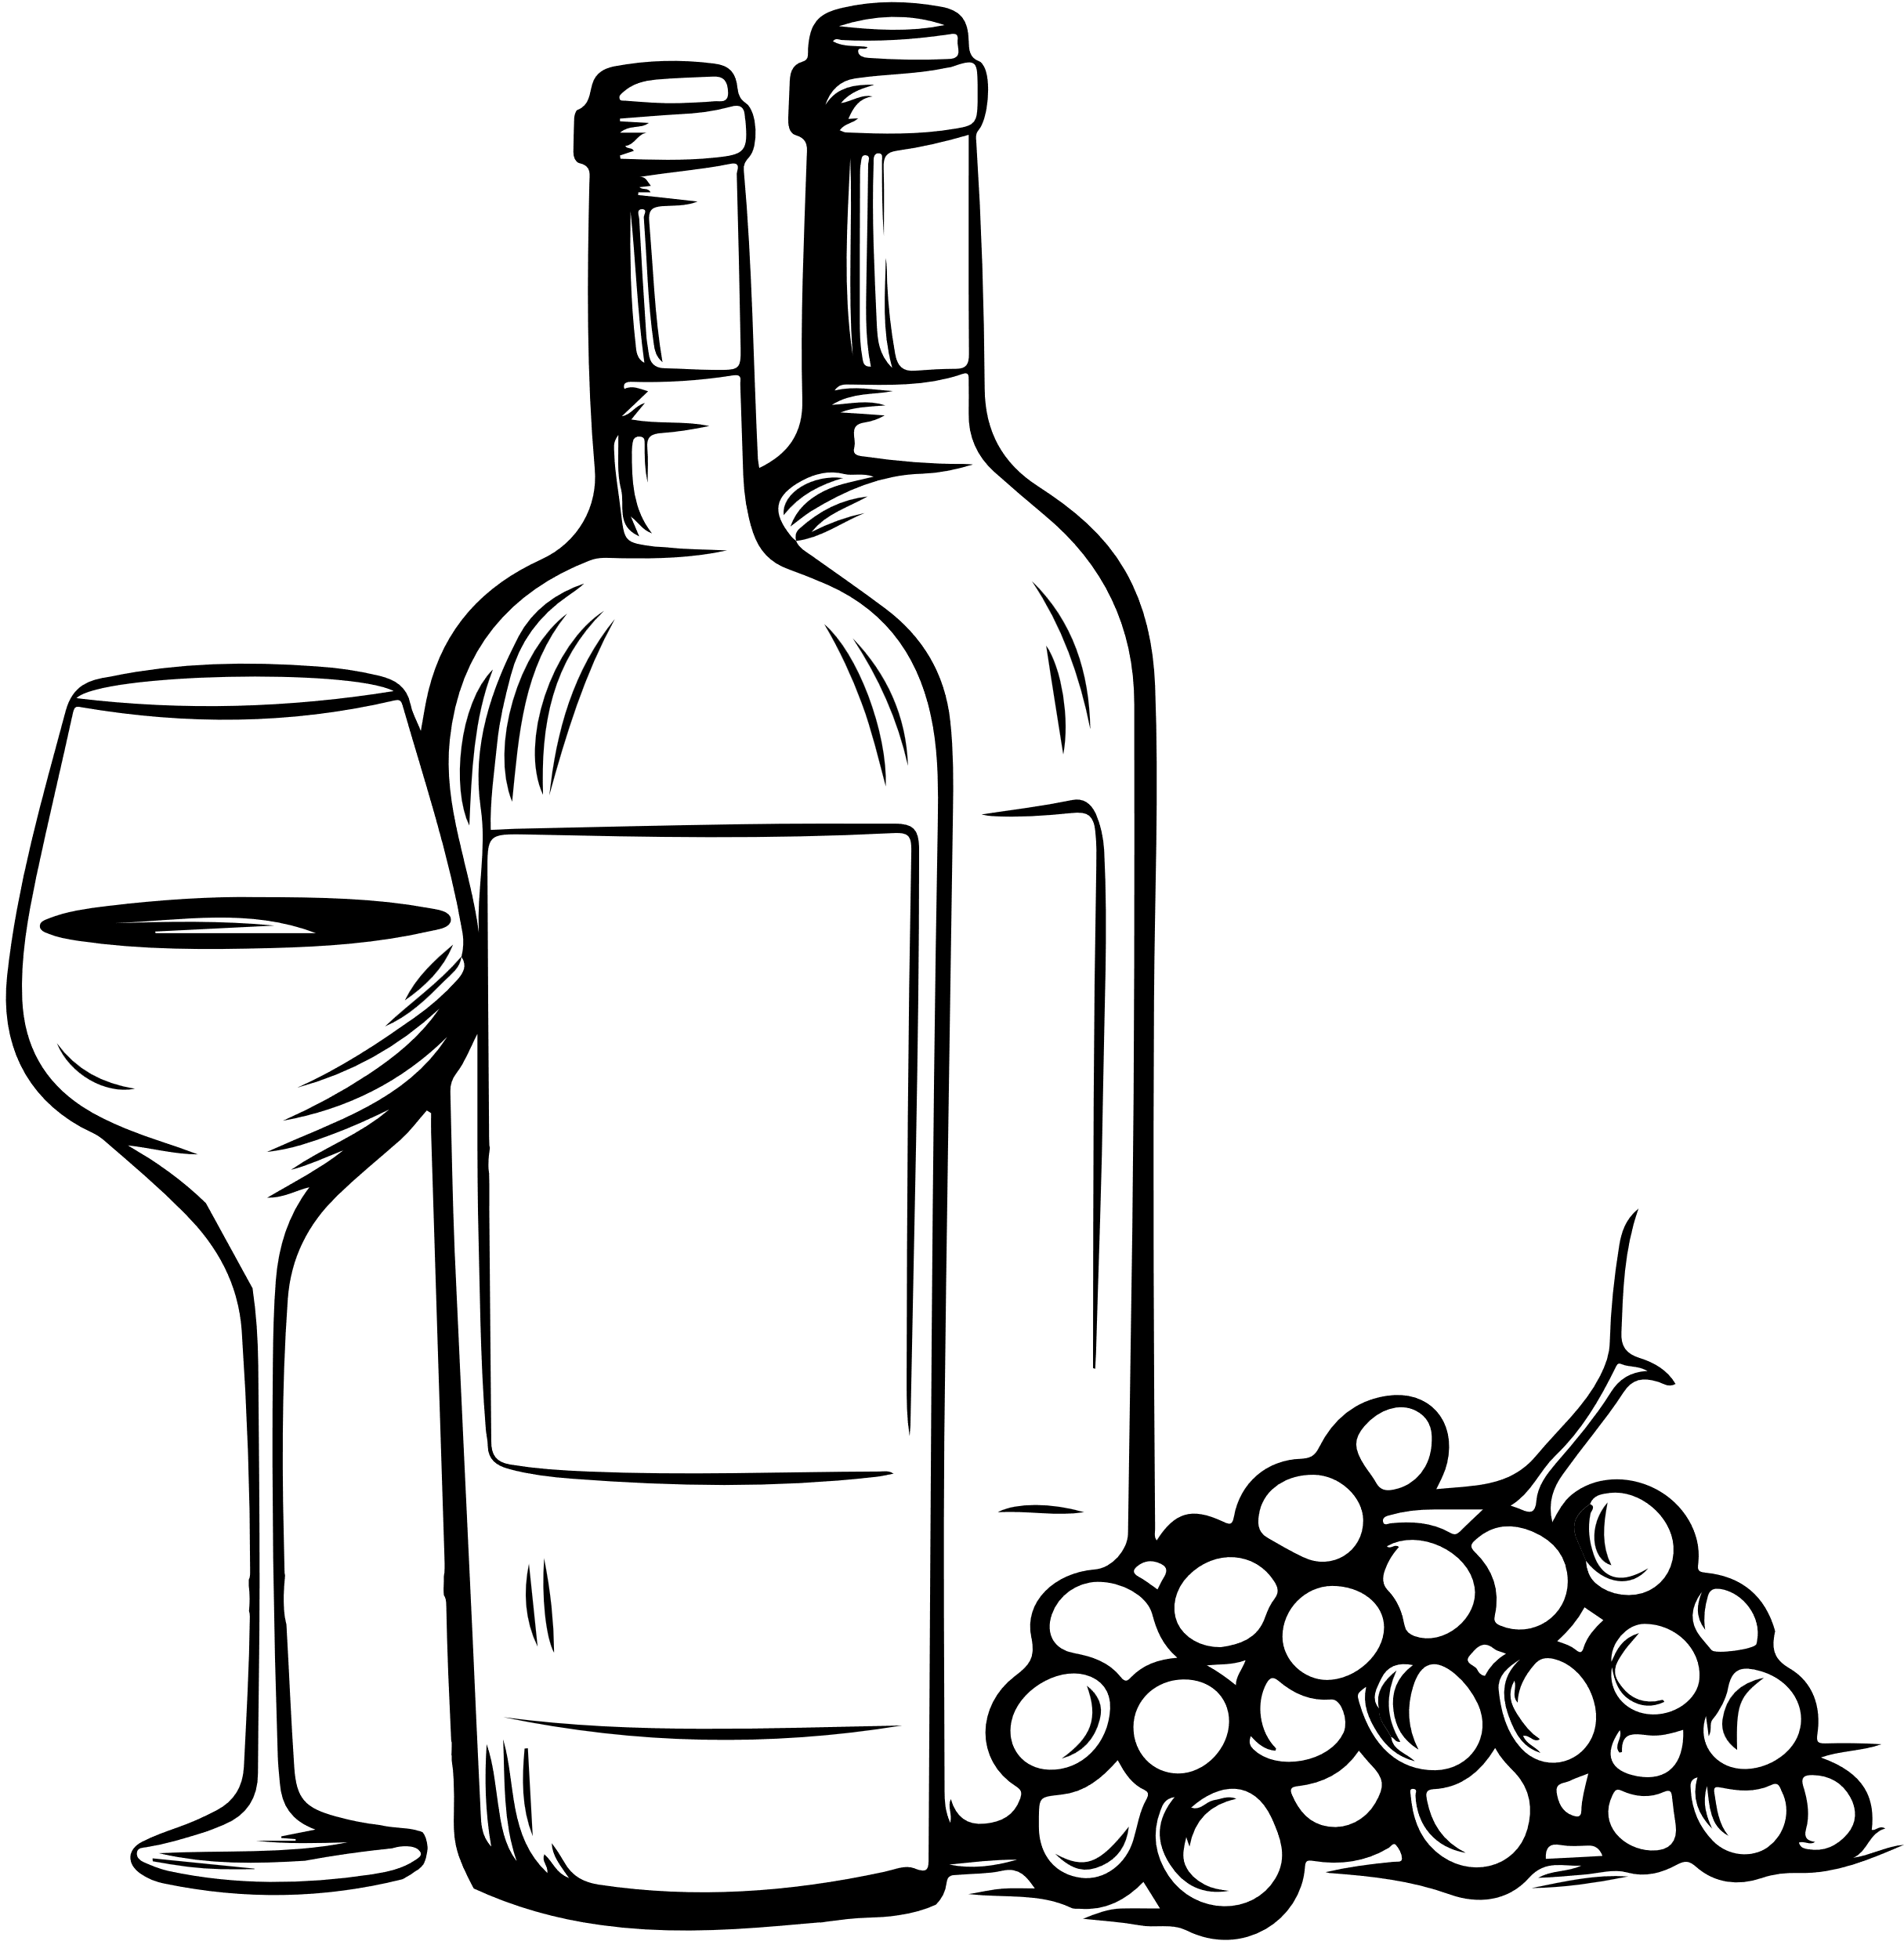
EXISTING PROBLEM
01
Traditional wine quality prediction relies on human tasters, which is time-consuming, expensive, and subjective. An efficient, data-driven solution is essential to consistently and accurately predict wine quality.

Slide 6
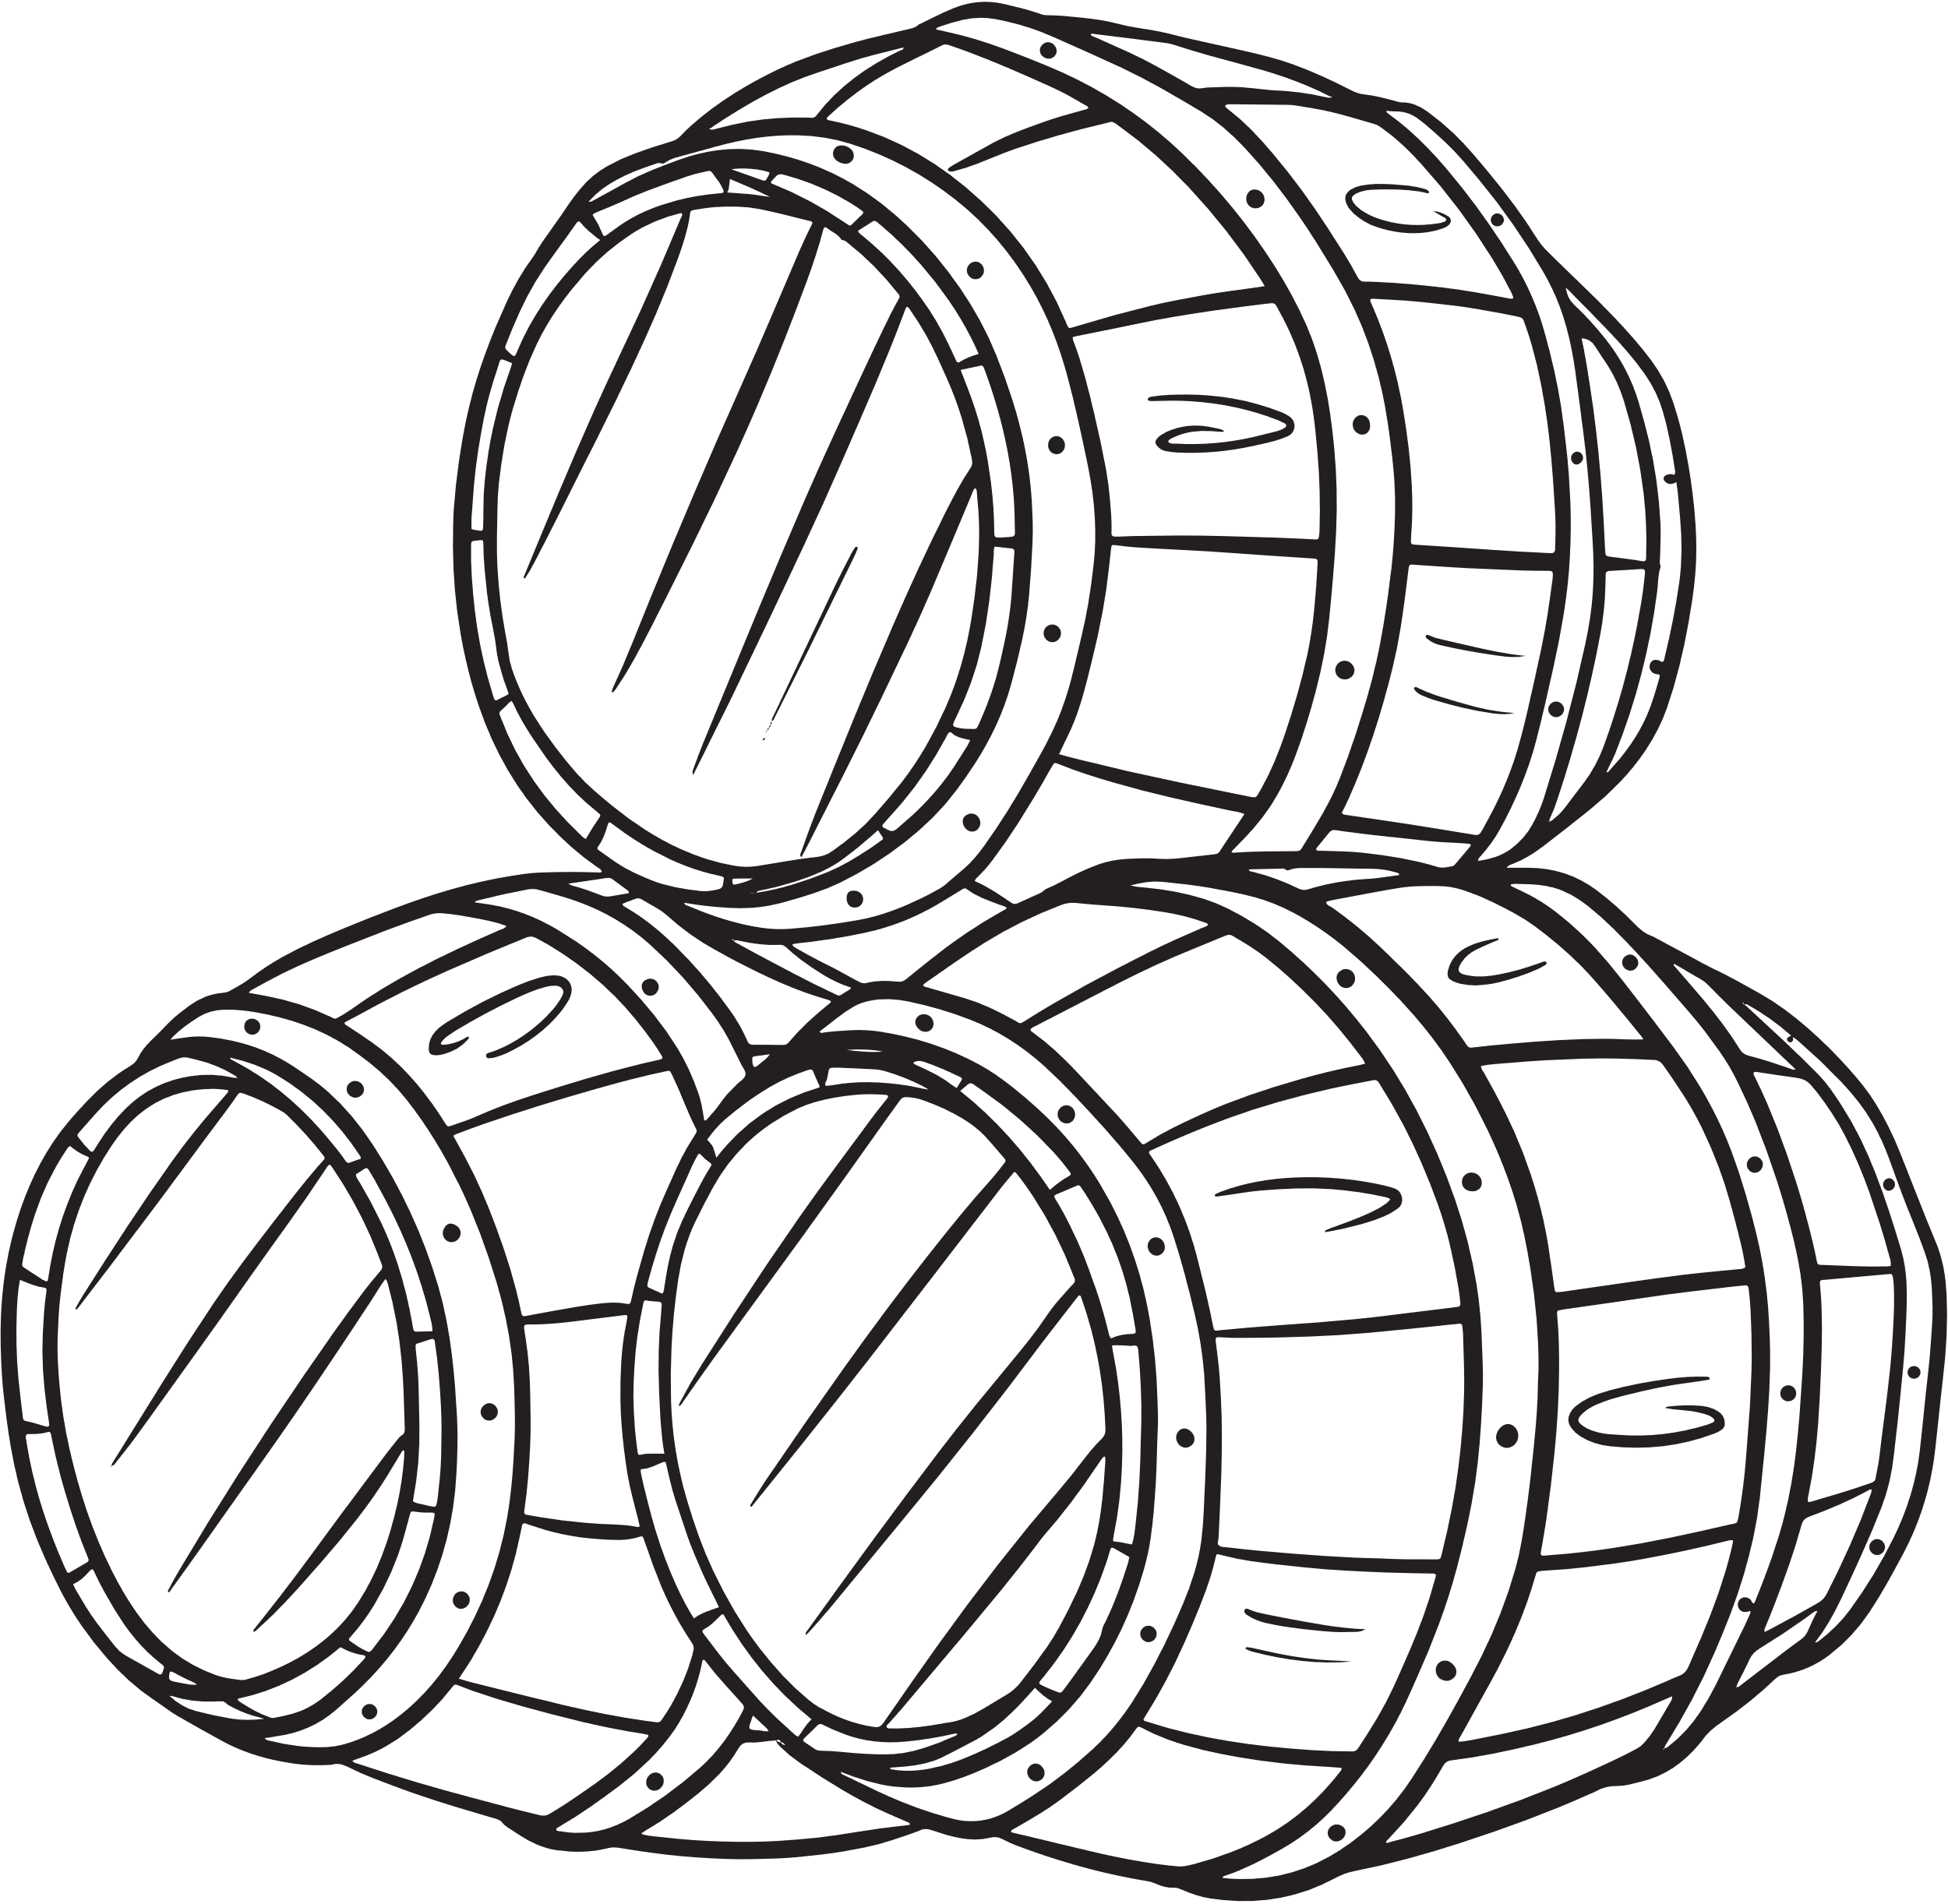
SOLUTIONS
SOLUTIONS OF THE PROBLEMS
We propose building a Wine Quality Prediction System using a Random Forest Classifier that accurately predicts wine quality based on chemical parameters. This model will utilize labeled data from the Wine Quality Dataset and apply ensemble learning techniques to achieve high accuracy while preventing overfitting.

Slide 7



TECHNOLOGIES USED
Python
Libraries
Dataset
Environment: Google Colaboratory
•NumPy: For numerical computations
•Pandas: For data manipulation
•Scikit-learn: For machine learning algorithms
•Matplotlib / Seaborn: For data visualization
Wine Quality Dataset from Kaggle

Slide 8
ARCHITECTURAL DIAGRAM
•A flowchart illustrating the data flow through various stages:Input: Wine chemical parameters (e.g., acidity, sugar, citric acid)
•Data Preprocessing: Feature scaling, binarization, data splitting
•Model Training: Random Forest Classifier
•Prediction: Wine quality classification

Slide 9
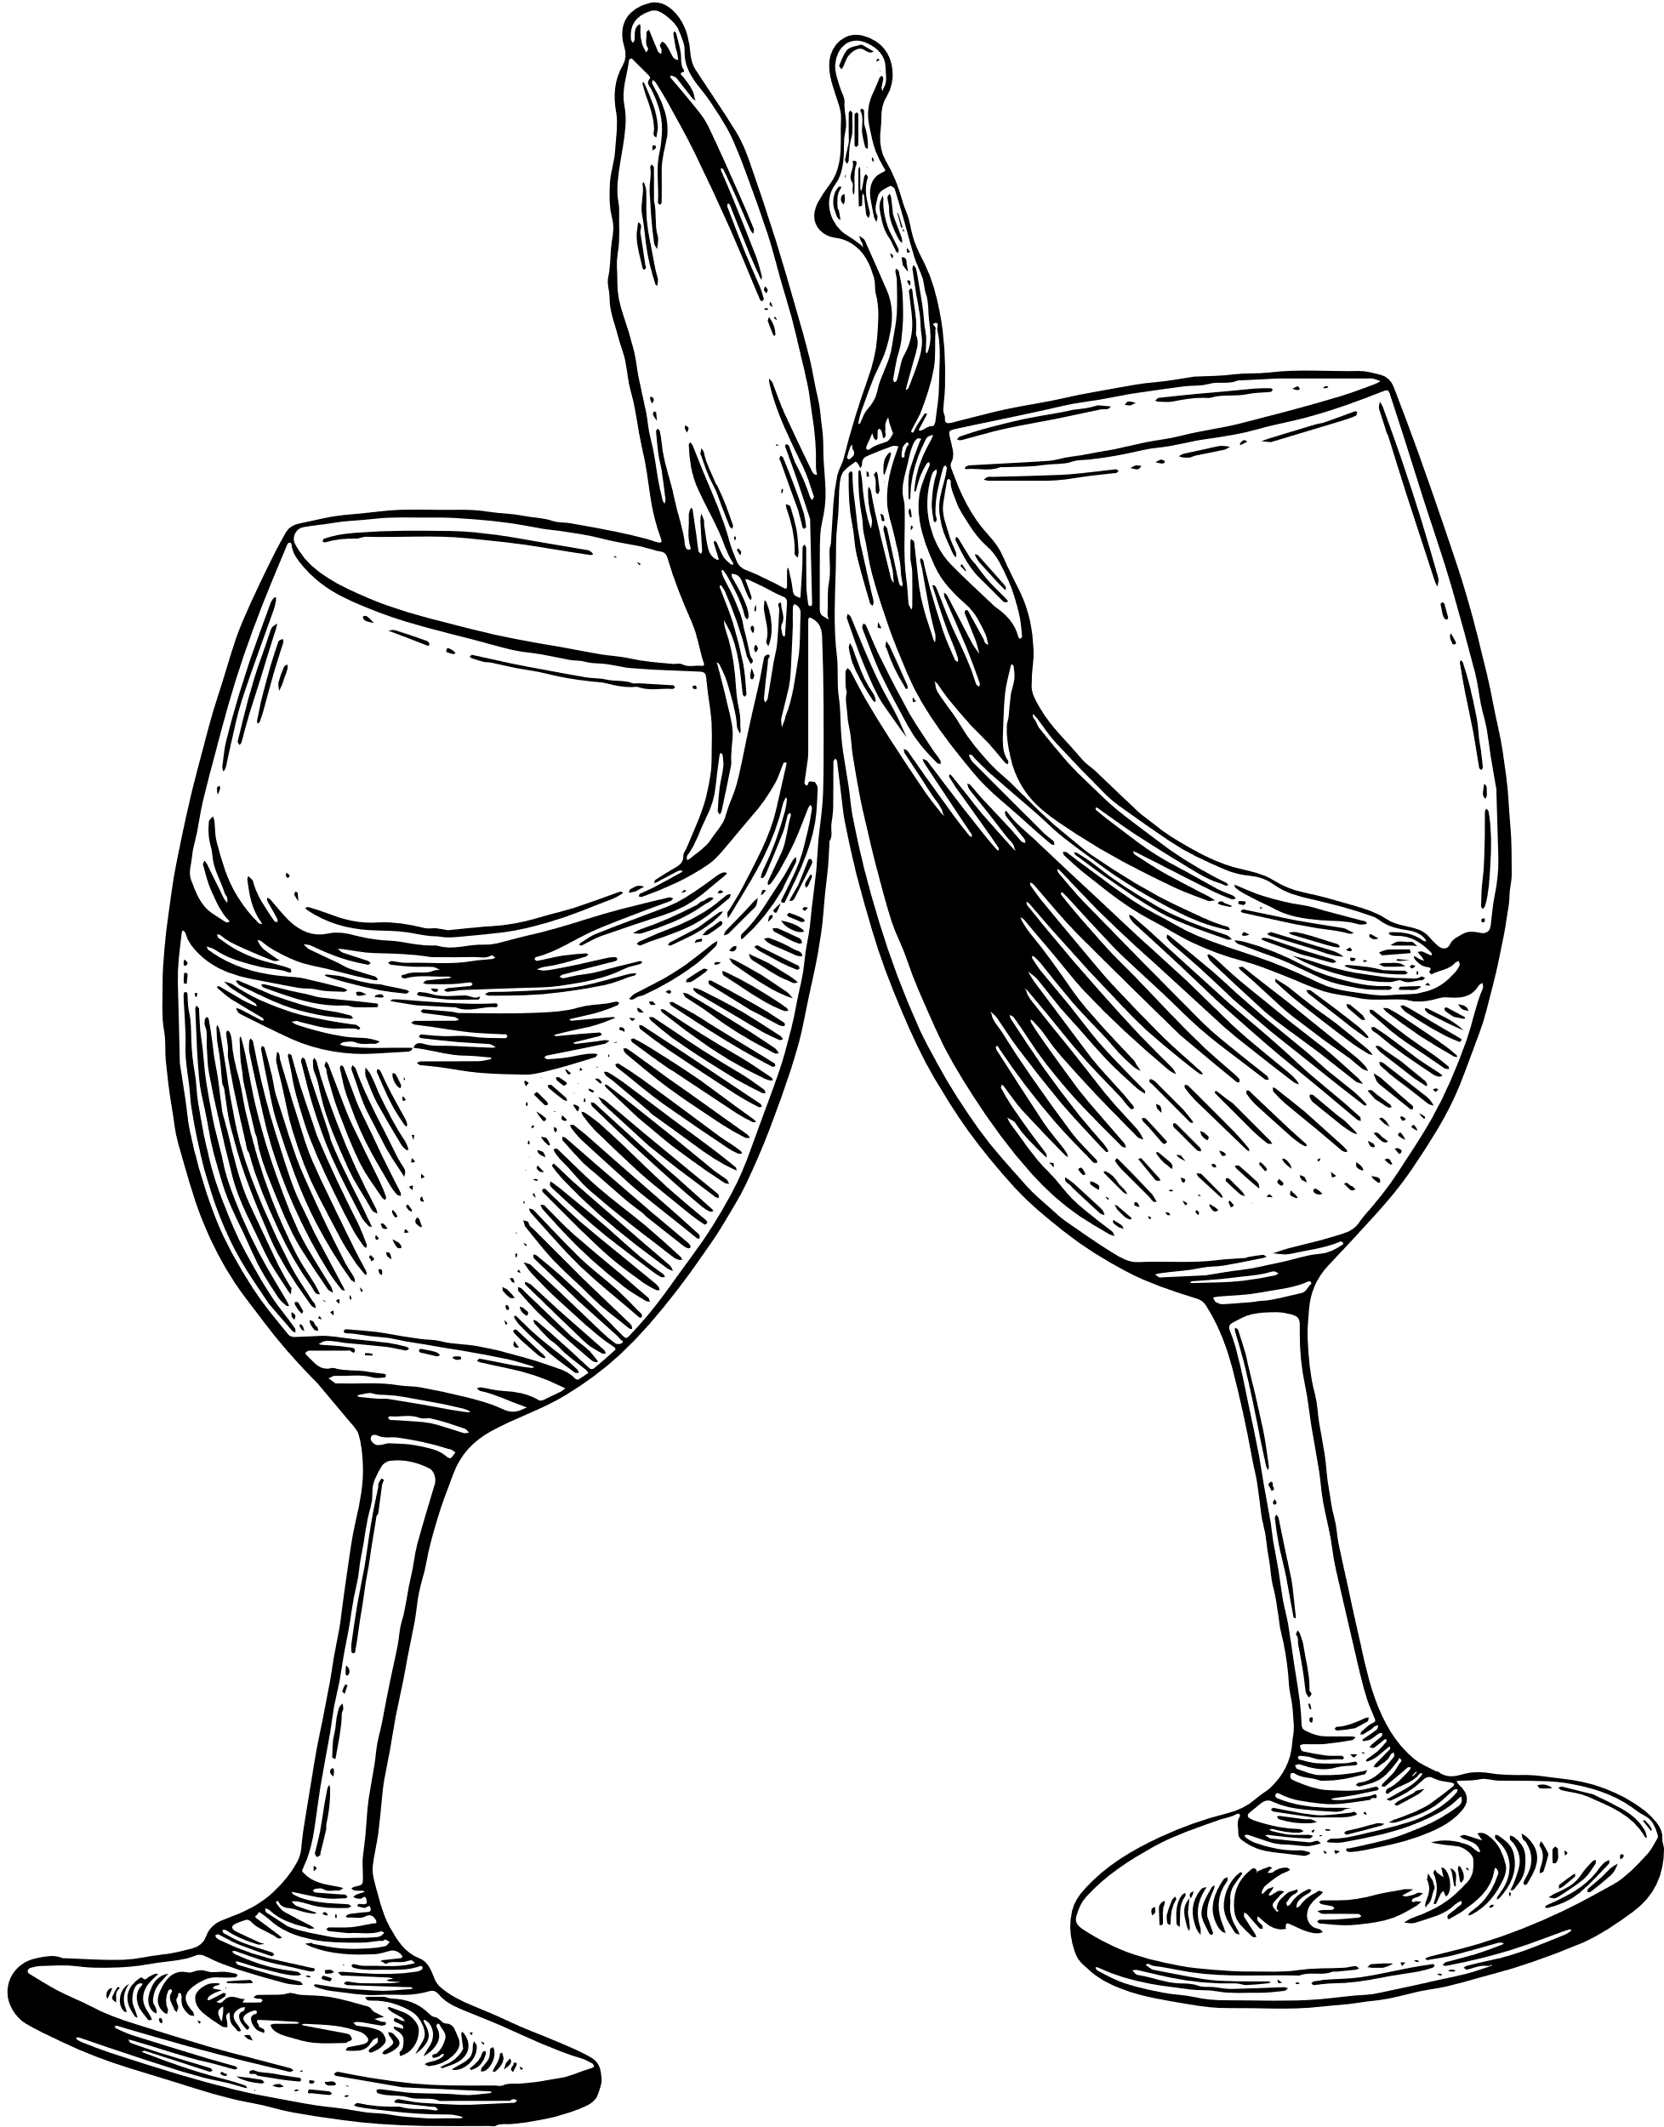
METHODOLOGIES
4. Binarizing Wine Quality Scores:
Convert quality scores into binary classes (e.g., quality ≥ 6 is 'good’).
5. Splitting the Data:
Divide the dataset into training (80%) and testing (20%) sets using train_test_split.
Data Preprocessing
1. Importing the Dataset:
Load the Wine Quality Dataset using Pandas.
Inspect the dataset to understand its structure.
2. Handling Missing Values:
Check for missing values and decide on a strategy:
Remove rows with missing values or impute them with the mean/median.
3. Scaling Features:
Standardize the features to improve model performance.
Use Min-Max scaling or Z-score normalization.

Slide 10
METHODOLOGIES
Model Training Algorithm:
3. Testing the Model:
Assess performance with the testing set.
Measure accuracy, precision, and recall.
4. Random Forest Mechanism:
Ensemble of Decision Trees: Constructs multiple trees from random training data subsets, capturing diverse data aspects.
Aggregation for Accuracy: Combines predictions via majority voting to improve accuracy and minimize overfitting, leading to a stronger classification model.
Random Forest Classifier:
Choose the Random Forest algorithm for its effectiveness in handling complex datasets.
2. Training Process:
Train the model using the training data.
Set parameters like the number of trees (e.g., n_estimators=100).

Slide 11

RESULTS
CLIENT’S SATISFACTION
The Random Forest model achieved an accuracy of 93% on the test data.
The system can accurately predict whether a wine is of good or poor quality based on its chemical composition.
Feature analysis indicates that citric acid positively correlates with quality, while volatile acidity negatively correlates.
93%

Slide 12

CONCLUSION
The Wine Quality Prediction System offers an efficient means of assessing wine quality through machine learning. The Random Forest Classifier demonstrated high accuracy, highlighting the potential of machine learning models in automating and enhancing traditional quality assessment processes within the wine industry.

Slide 13
REFERENCES
Siddhardhan, "Wine Quality Prediction System" (YouTube Video)
Kaggle, "Wine Quality Dataset“
Scikit-learn documentation for Random Forest Classifier
Google Collaboratory for code execution

Slide 14
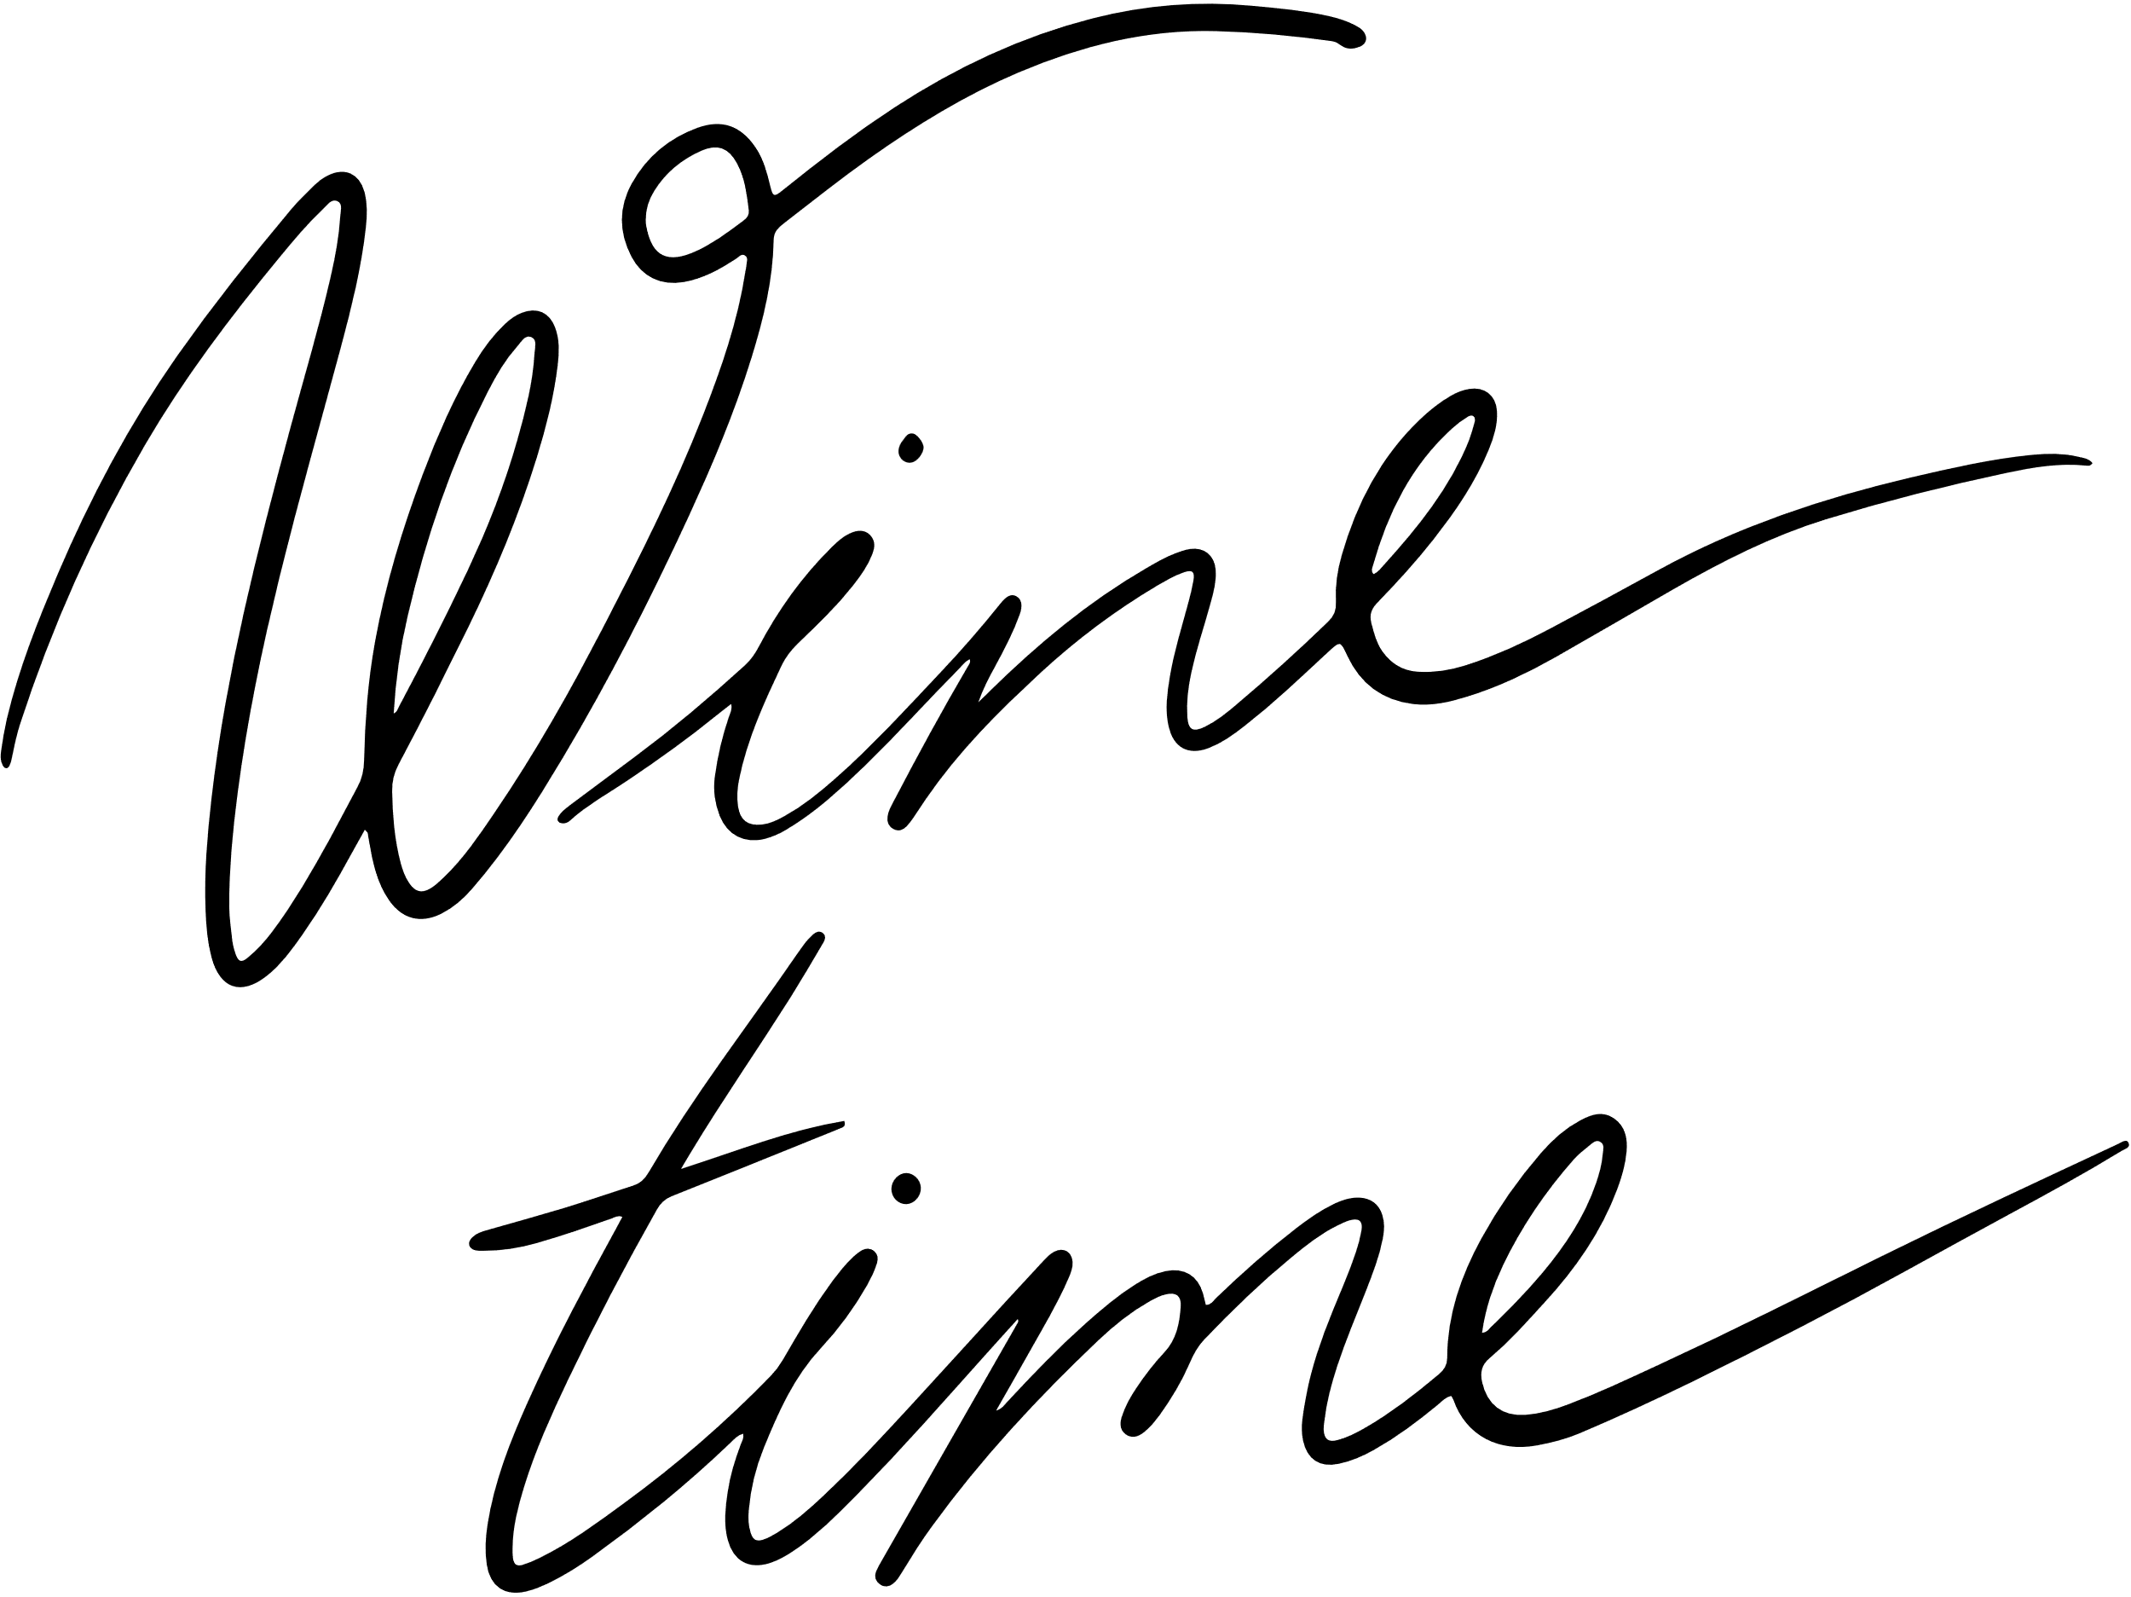
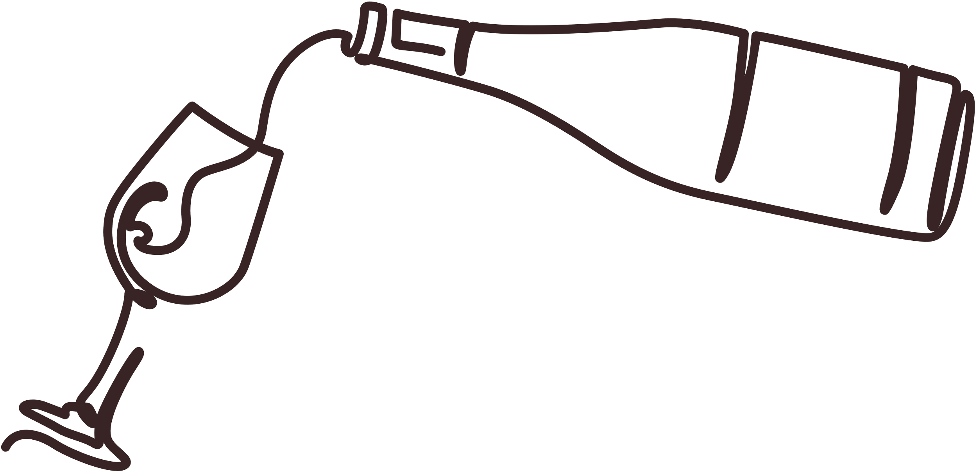
THANK YOU

